Slide 1



Avoiding the ‘Escalation Trap’
Dan Conley
Director of In-School AP
daniel.conley@coopacademies.co.uk

Slide 2
Objectives
Avoiding the ‘escalation trap’
Your default setting
De-escalation strategies

Slide 3
Objectives
Avoiding the ‘escalation trap’
Your default setting
De-escalation strategies

Slide 4
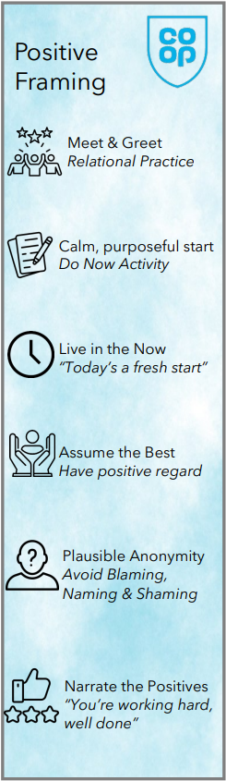
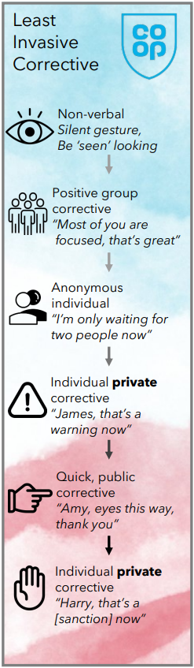
Avoiding the ‘Escalation Trap’
Step 1: Positive Framing

Slide 5
Routines
Meet & Greet
Do Now Activity
Relational Practice starts here
Routines / Purposeful Start

Slide 6
Positive Framing
To gain the best from pupils, we should strive to:
Live in the Now
Assume the Best
Allow Plausible Anonymity
Narrate the Positives
Today’s a fresh start
Cultivate positive regard
Not naming & shaming
What’s good / improving

Slide 7
Live in the Now
Avoid reminders of past issues
“Aliyah, I’m not going to tolerate a repeat of last lesson”
“Year 9, your recent attitude has been appalling”
↓
“Aliyah, great start. Really settled. Thank you.”
“Year 9, I have high expectations of you in this practical”

Slide 8
Assume the best
Don’t assume laziness, selfishness and deliberate disrespect
“Just a minute, some people don’t seem to think they have to push in their chairs when they leave.”
↓
“Just a minute, some people seem have forgotten to push their chairs under.”

Slide 9
Plausible Deniability
Allow pupils the benefit of the doubt providing they are making a good-faith effort. Correct them without using names, where possible.
“Let’s just do one last check all everyone’s hands are empty”
“I’m waiting for the last few people to put their equipment down”

Slide 10
Narrate the Positives
Make the public conversation about success / improvement
“That’s outstanding effort, Hamza”
“Brilliant lab work, Year 8. You’ve been really focused”
“Asma, this was your best performance so far, keep going”
“Liam, you really persevered today, I’m proud of you”

Slide 11
Reframe these statements…
Stop tapping that pen now or I’ll send you out
Your effort last week was pathetic. I need to see change.
What makes you think you can do nothing all lesson?
You are not holding that test tube right
Stop shouting out the answers

Slide 12
Avoiding the ‘Escalation Trap’
Step 2: The Least Invasive Corrective

Slide 13
Least Invasive Corrective
[silent gestures]
“You should all be…”
“Just two pupils left now…”
“Ali, I’ve noticed…”
“Ali, eyes this way”
“Ali, let’s talk at the end”
Non-verbal
Positive Group
Anonymous Individual
Private Individual
Quick Public
Private Individual

Slide 14
Least Invasive Corrective
Non-Verbal Intervention:
Proximity - move closer to pupils you want to correct
Stand tall and be seen looking
Choose your vantage point (e.g. corner of room)
Eye contact and silent signals
Gently tap pupil’s desk / point to their work

Slide 15
Least Invasive Corrective
Positive Group Corrective:
Explain what pupils should be doing, not what they shouldn’t
“We’re holding our whiteboards up”
Anonymous Individual Corrective:
Make it explicit that not everyone is where they need to be
“Just waiting for the last two people”

Slide 16
Least Invasive Corrective
Individual Private Corrective:
Get down to the level of the pupil
“Ali, is everything ok? Let’s look at this together… I’ll come back in 5 minutes - show me what you can do”
“Ali, you seem really distracted today and I’m wondering how to help, as I don’t want you to have a sanction.”

Slide 17
Least Invasive Corrective
Quick Public Corrective:
Limit the amount of time the pupil is ‘onstage’
Fast focus on telling the pupil what to do right
“Laveeza - whiteboard, thank you!”
“Riley - eyes forward!”

Slide 18
Least Invasive Corrective
Individual Private Corrective:
“Ali, I’ve given you a final warning. Your behaviour is still impacting on the learning of other pupils, so we’ll need to speak at the end of the lesson about your sanction.”

Slide 19
Least Invasive Corrective
Removal from Lesson:
Should be a logical consequence and not a punishment
Following previous least invasive steps
Ideally recorded to build a picture of lost learning
A 1:1 conversation outside a classroom is also a great opportunity for relational practice without an audience

Slide 20
Objectives
Avoiding the ‘escalation trap’
Your default setting
De-escalation strategies

Slide 21
Your Next Move…
You spot a student who has headphones in with their hood up, walking towards you. You smile and mime a hand signal to prompt them to remove them. They make direct eye contact, say "no" and continue walking past, hitting a wall as they go. A group of students standing nearby - who saw the entire exchange - fall silent and turn their gaze to you, waiting to see how you’ll handle the public defiance.

Slide 22
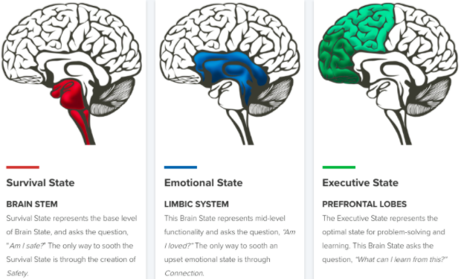
Your Default Setting
Power | Purpose
Winning the argument | Improving outcomes
Assuming threat / malice | Natural curiosity
Taking challenge personally | Remain impartial
Obedience at any cost | Understanding the ‘why’
Control | Confidence
Vs

Slide 23
Your Default Setting
Power | Purpose
Winning the argument | Improving outcomes
Assuming threat / malice | Natural curiosity
Taking challenge personally | Remain impartial
Obedience at any cost | Understanding the ‘why’
Control | Confidence
Vs
Fatigue / Burnout
Anxiety / Stress
Prior Negative Experiences
Fear of Judgment

Slide 24
Your Default Setting
Power | Purpose
Winning the argument | Improving outcomes
Assuming threat / malice | Natural curiosity
Taking challenge personally | Remain impartial
Obedience at any cost | Understanding the ‘why’
Control | Confidence
Vs
Self Care
Relaxation Routines
Consider Triggers
Advocacy / Support

Slide 25
Objectives
Avoiding the ‘escalation trap’
Your default setting
De-escalation strategies

Slide 26
The Brain Stem
Our life support centre
Regulates pulse, breathing, blood pressure
Develops first, mature by birth

Slide 27
The Limbic System
The seat of our emotion
Relational connection and attachment
Matures by 10-13 years old

Slide 28
The Cortex
Home of uniquely human capabilities
Logical reasoning, planning, inhibiting
Fully matures by 25 years old

Slide 29
Neurosequential
Approach
Reason
The brain is arranged, and develops hierarchically
To access the cortex, processing moves ‘up’ through lower centres
Priorities at these stages can ‘block’ higher order reasoning
Relate
Regulate

Slide 30
Classroom Strategies?
Reason
Predictable routines
Countdown timers
Minimise noise
Crouch beside
Paper clips & blu-tack!
Time out & check-in
Box breathing (4,4,4,4)
Relate
Regulate

Slide 31
Strategies Around School?
Reason
Relatable approach
Calm voice
Stand beside
Let’s walk
Trusted adult check-in
Exit route / safe base
Box breathing (4,4,4,4)
Relate
Regulate

Slide 32
Avoiding the ‘Escalation Trap’
Dan Conley
Director of In-School AP
daniel.conley@coopacademies.co.uk

Slide 33

Extension Activity
What went wrong?
Assertive body language
Blocking exits / cornering
Disinterest / dismissive
Verbal threats / challenges
Lookout
System
An Incident in School: BBC3

